Slide 1
LAB EQUIPMENT
Review Activity

Slide 2
For each slide identify the name of the equipment, what the tool is used for, and explain any safety concerns for using it.

Slide 3
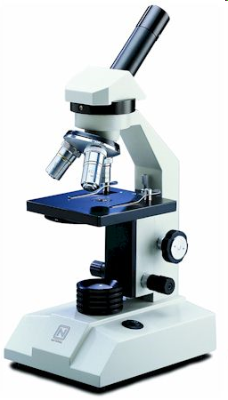

Slide 4
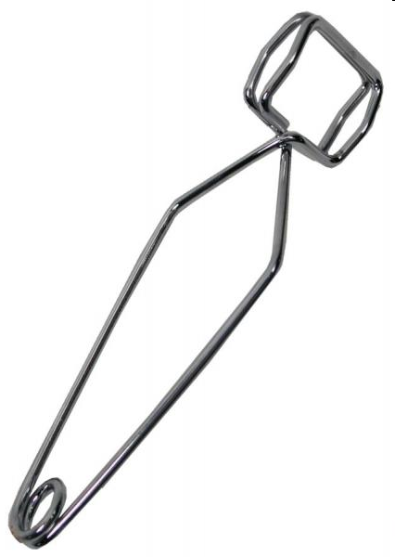

Slide 5
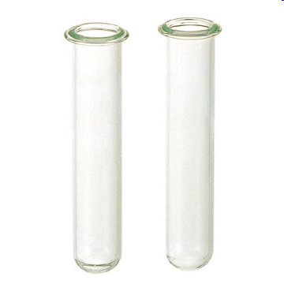

Slide 6


Slide 8
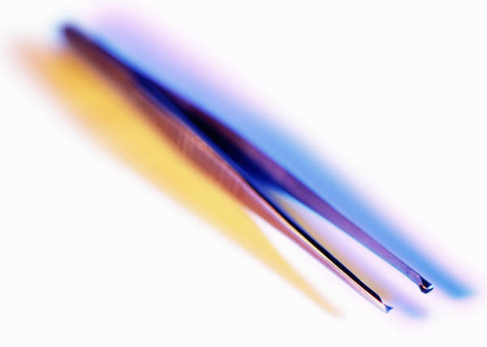

Slide 9


Slide 11
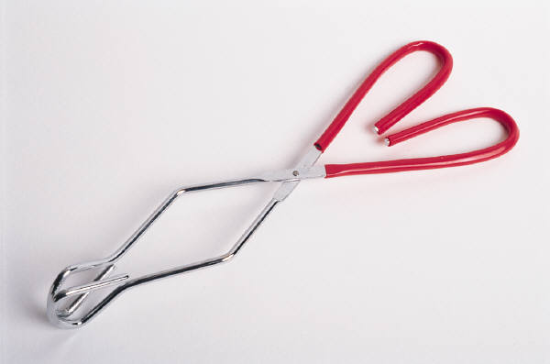

Slide 12
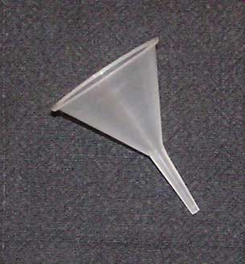

Slide 13
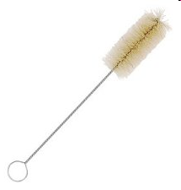

Slide 14
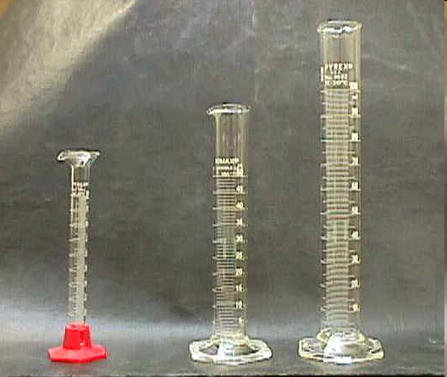

Slide 15
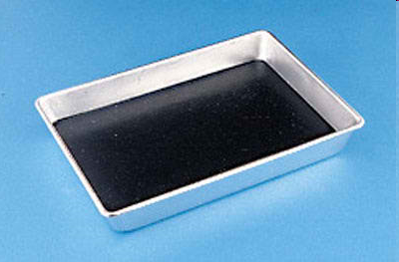

Slide 16
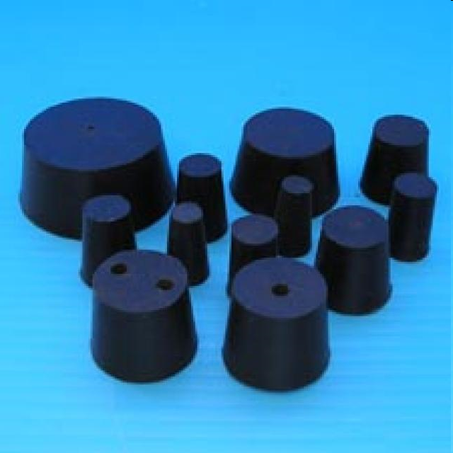

Slide 17
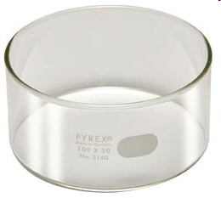

Slide 18


Slide 19
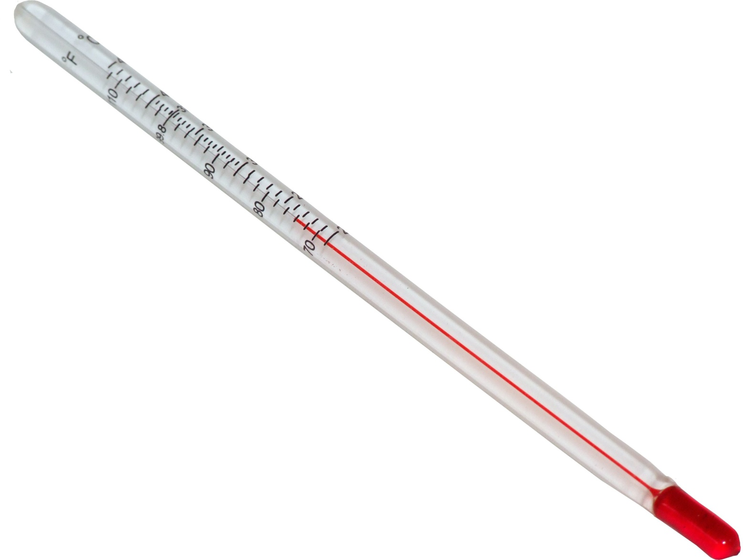

Slide 20
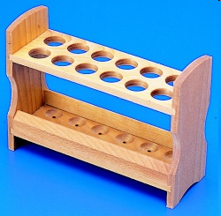

Slide 21
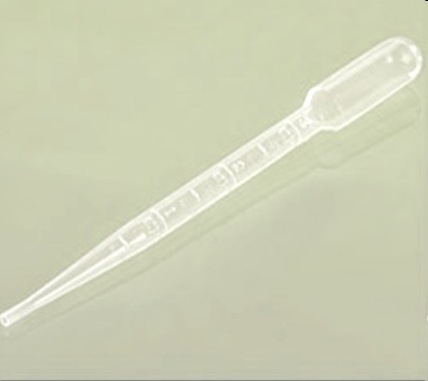

Slide 22
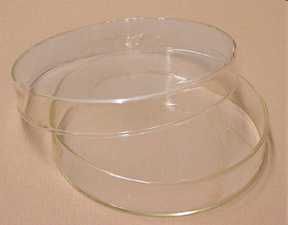

Slide 23
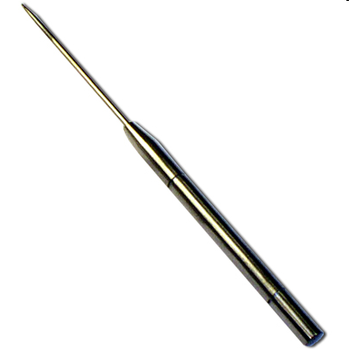

Slide 24


Slide 25
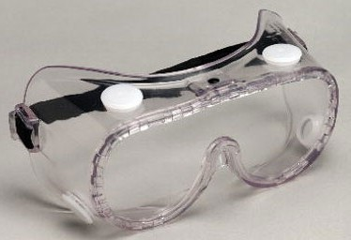

Slide 26
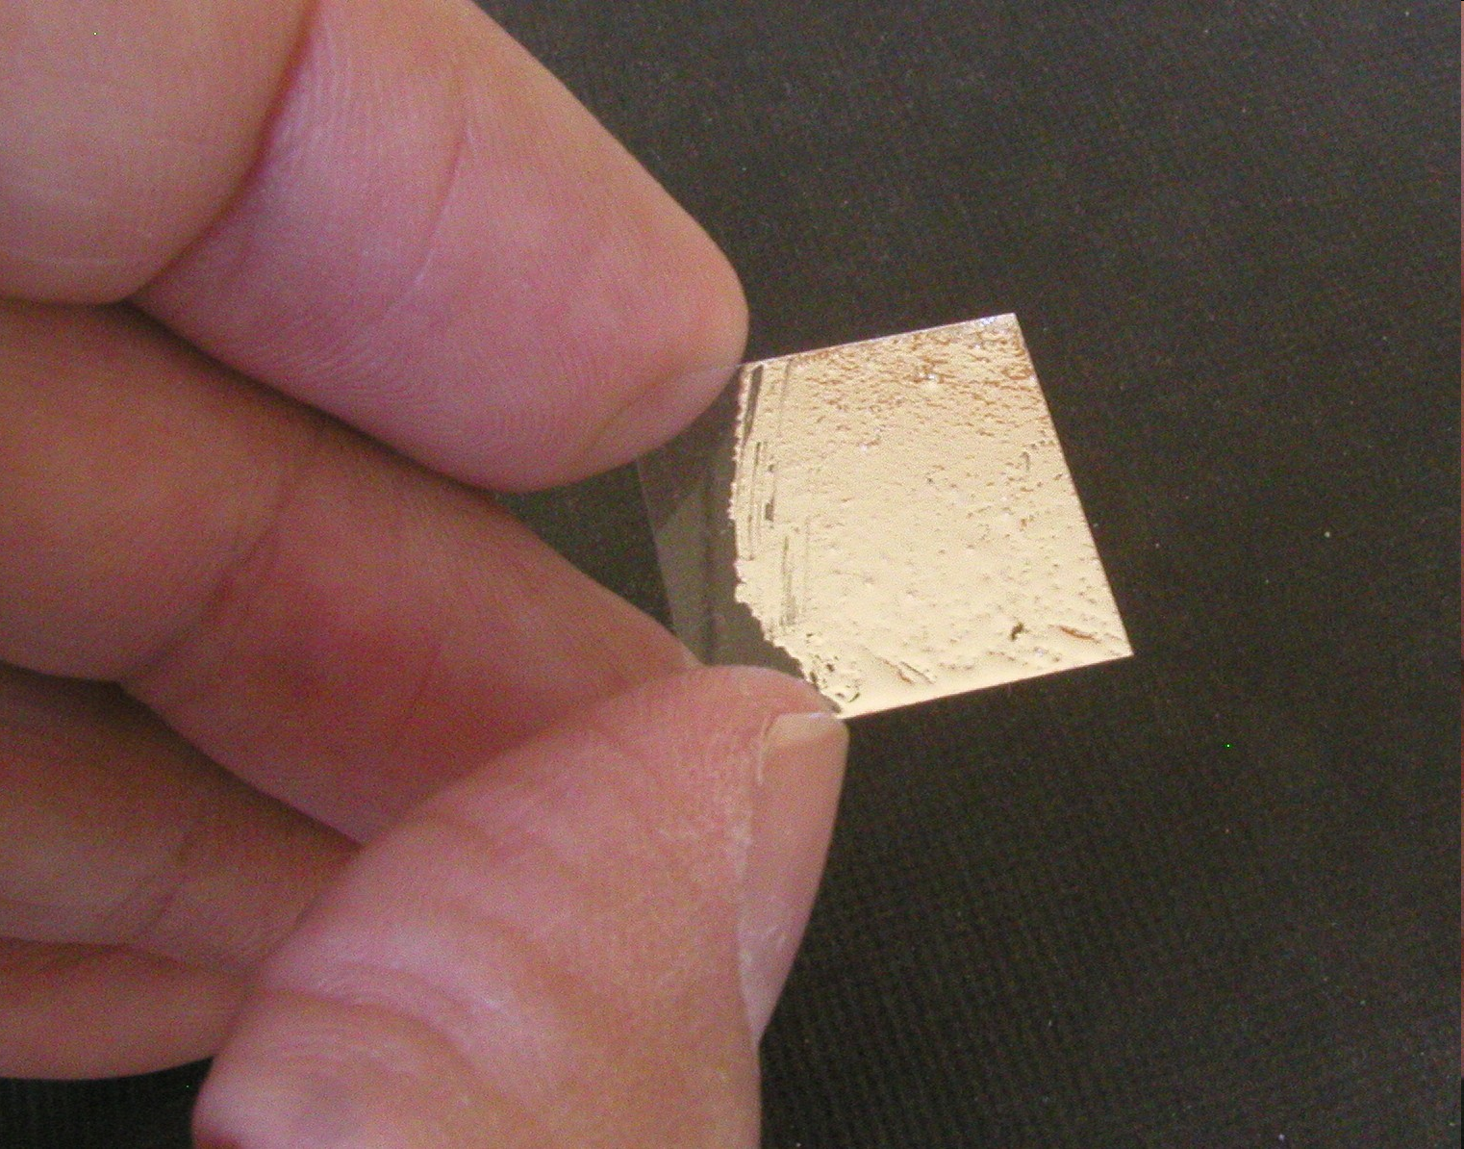

Slide 27


Slide 28
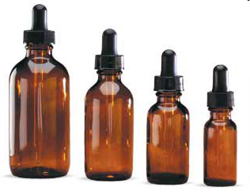

Slide 29
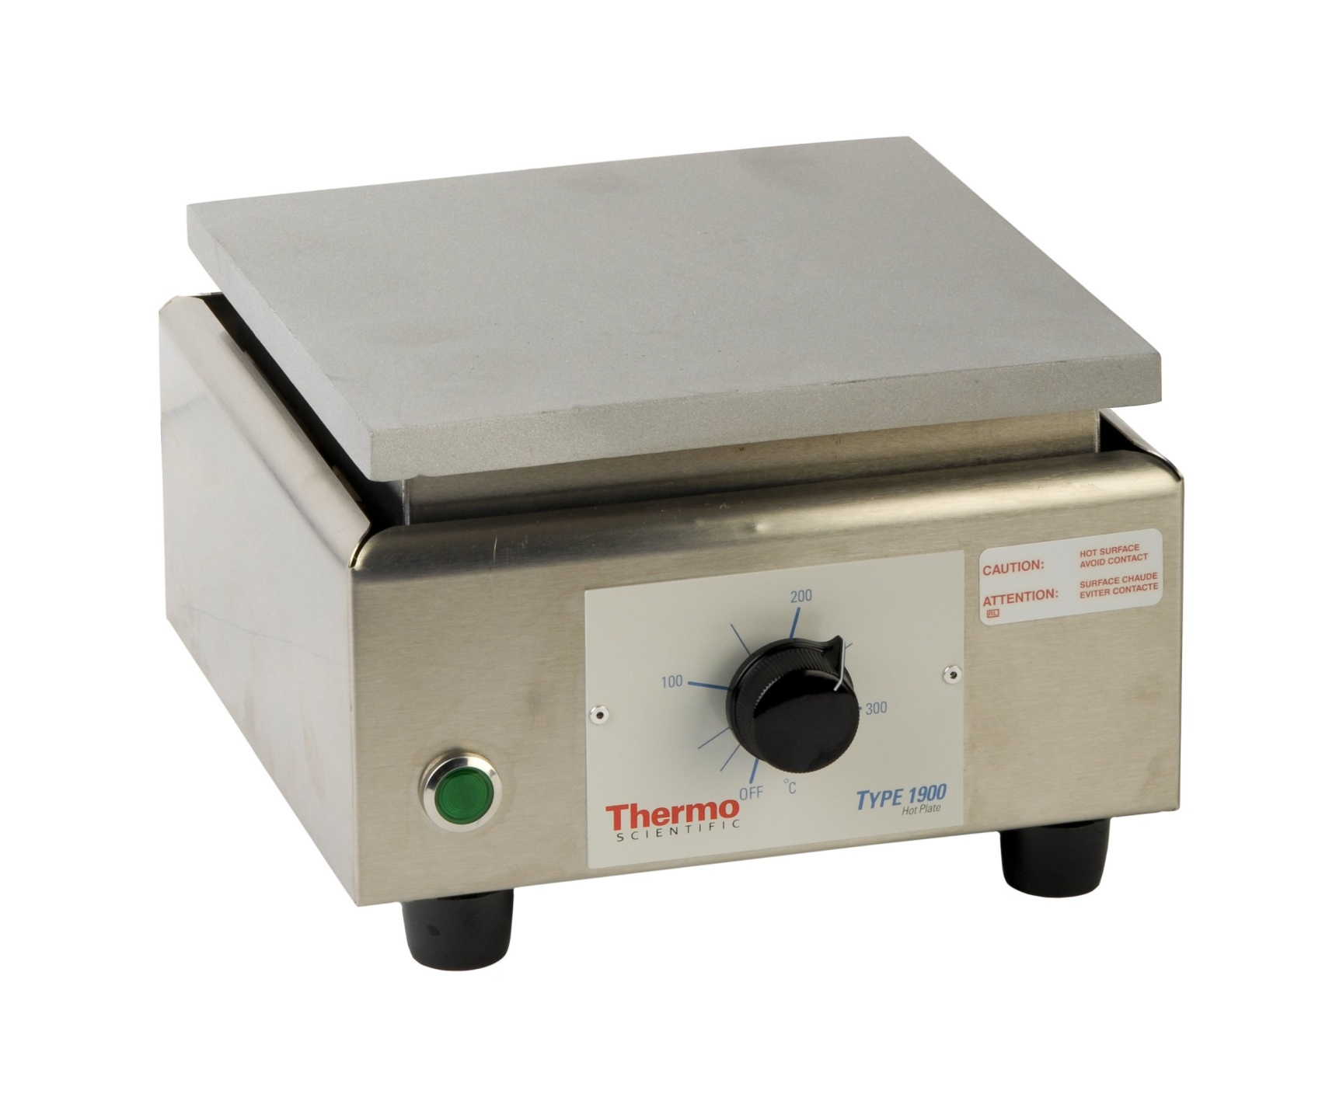

Slide 30
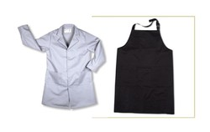

Slide 31
Safe or Unsafe?
Wearing plastic gloves when dissecting squid.
A student picking up pieces of broken glassware.
Wafting an odor gently towards your nose.
Using hand sanitizer after a lab instead of washing your hands.
Dumping your experiment down the sink when finished.

