Slide 1
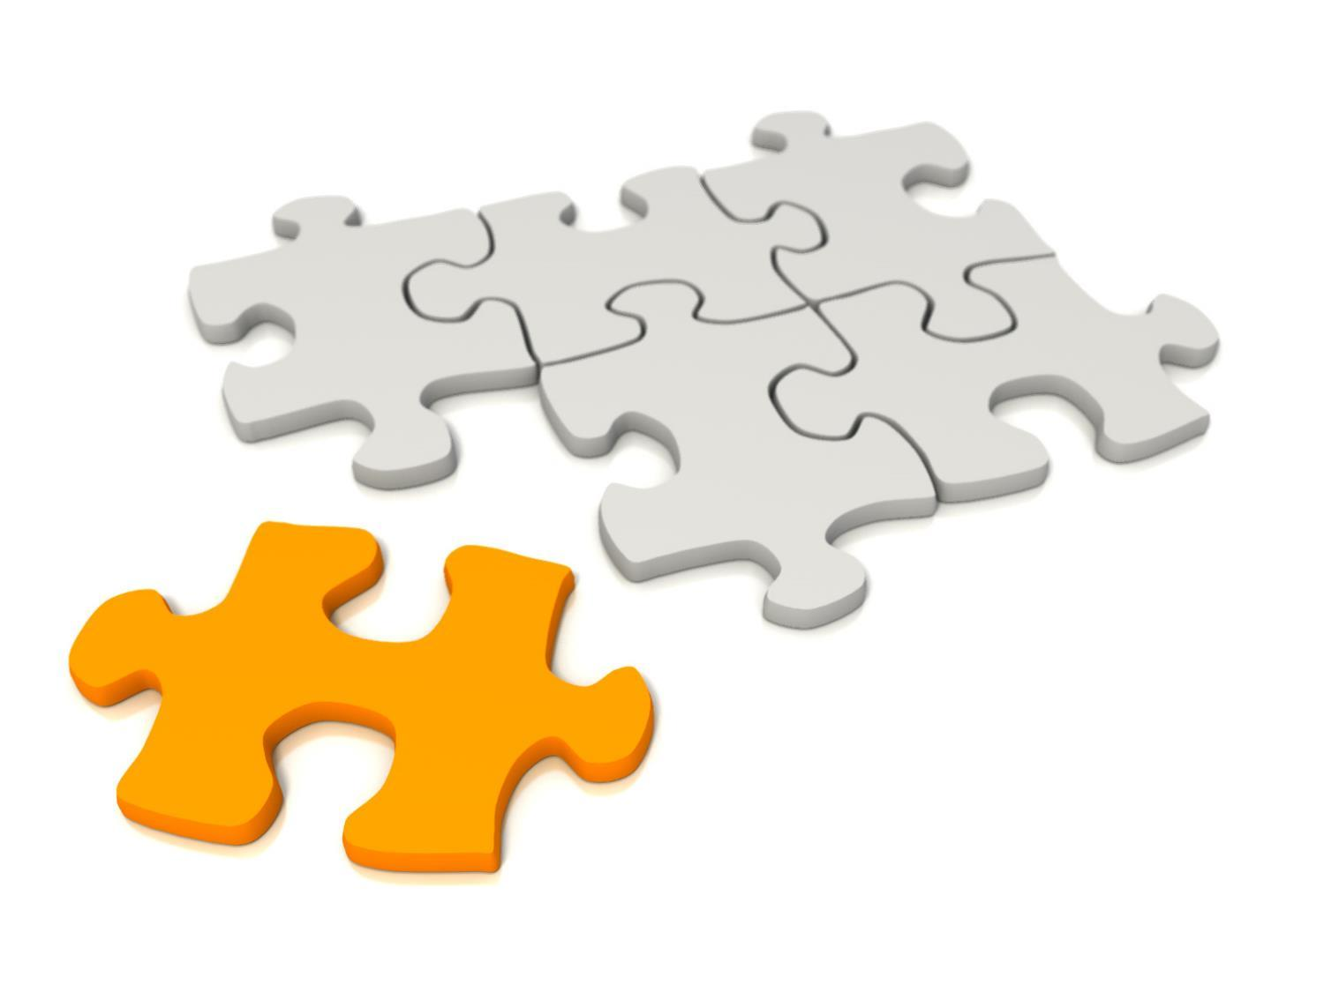
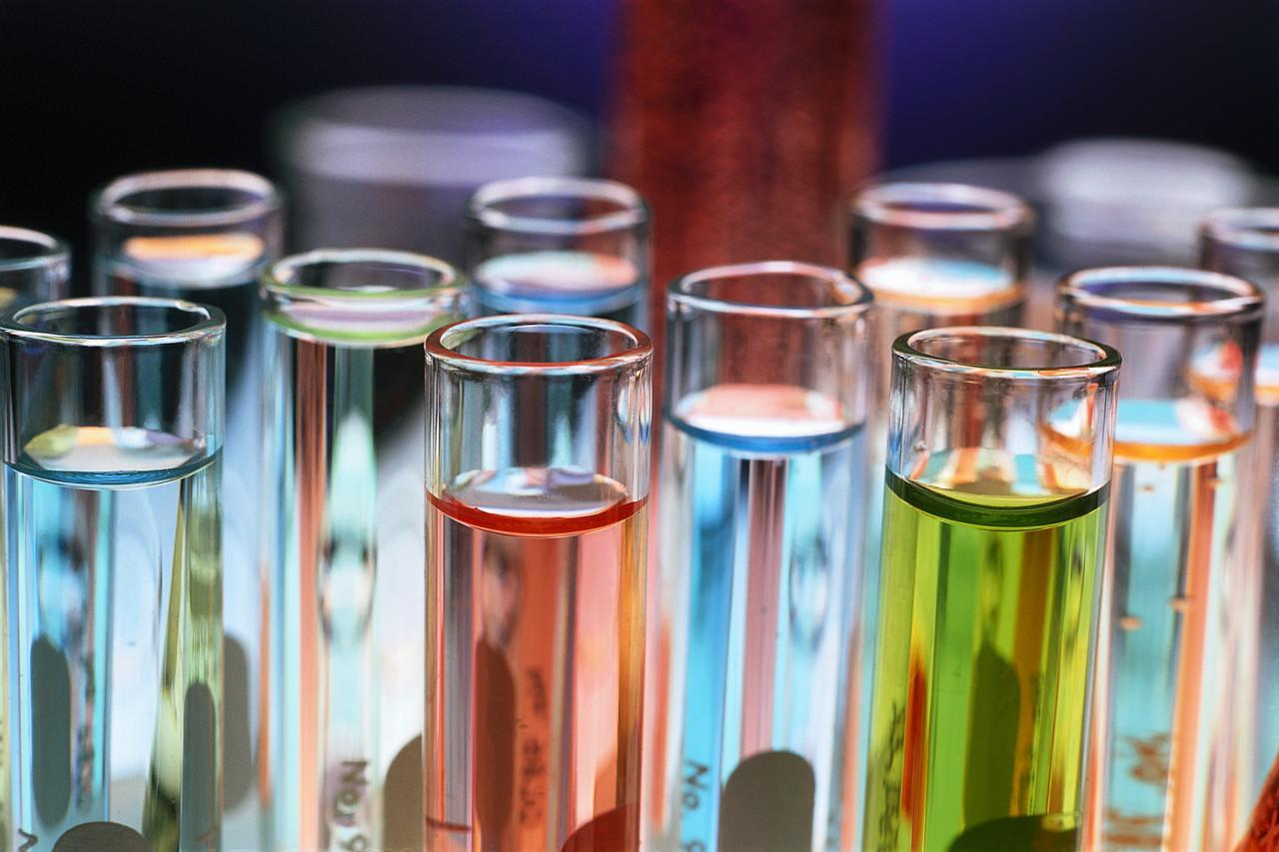
Lab Equipment Introduction

Slide 2
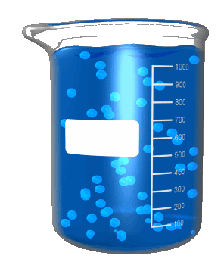
Beaker
Function:
Provides an approximate measurement of a liquid’s volume in liters (L) or millimeters (mL).
Sometimes we just use a CUP!

Slide 3
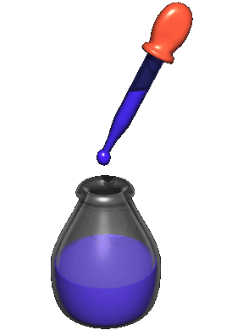
Pipette
Comes in different lengths
Function:
Transfers a small amount of liquid volume (drop by drop) by squeezing and releasing the bulb
NOT AN EYEDROPPER

Slide 4
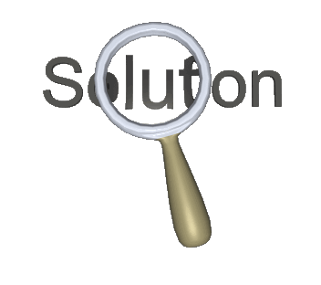
Hand Lens
Or Magnifying Lens
Function:
Makes objects look bigger for observation
Can be plastic or glass

Slide 5
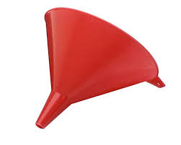
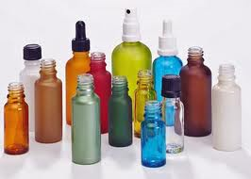
Funnel and Dropper Bottle
Function:
Used to store and neatly dispense various liquids using the pipette or dropper
Another tool to help transport from container to container

Slide 6
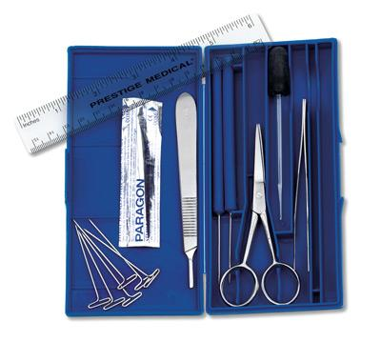
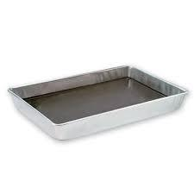
Dissecting Equipment
Function:
Helps to cut, observe, transfer, and examine biological specimens.
Includes: dissection needle, scissors, scalpel, forceps, T-pins and dissecting Pan

Slide 7
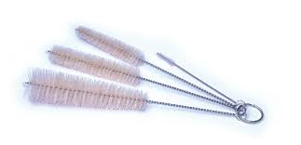
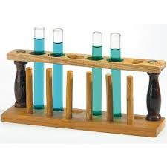
Test Tube Brush and Rack
Function:
The brush is for proper cleaning of the test tubes
The rack securely holds the test tubes in place in an upright position

Slide 8
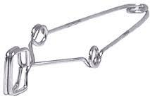
Test Tube Clamp
Function:
Holds the test tube
Used when the test tube contains dangerous or hot chemicals

Slide 9
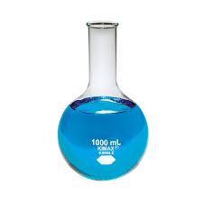
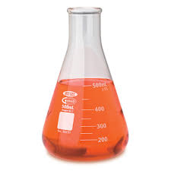
Flask
Function:
Container for chemicals
Measures volume
Cylindrical neck allows liquids to be swirled

Slide 10
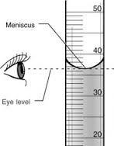
Graduated Cylinder
Look closely
Function:
Measures the volume of liquid in mL
The liquid is measured at the meniscus (curved surface of the water)

Slide 11
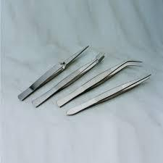
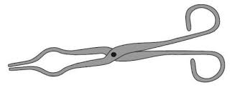
Forceps and Tongs
Function:
Both of these tools come in a variety of sizes and styles
They are used for grasping things that require precision

Slide 12
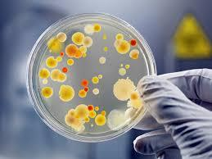
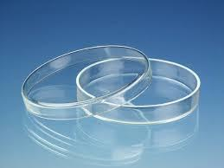
Petri Dish
Function:
Allows the growth and observation of organisms
Looks like a clear shallow dish with a lid
Can be plastic or glass
Can be cleaned and re-used again

Slide 13
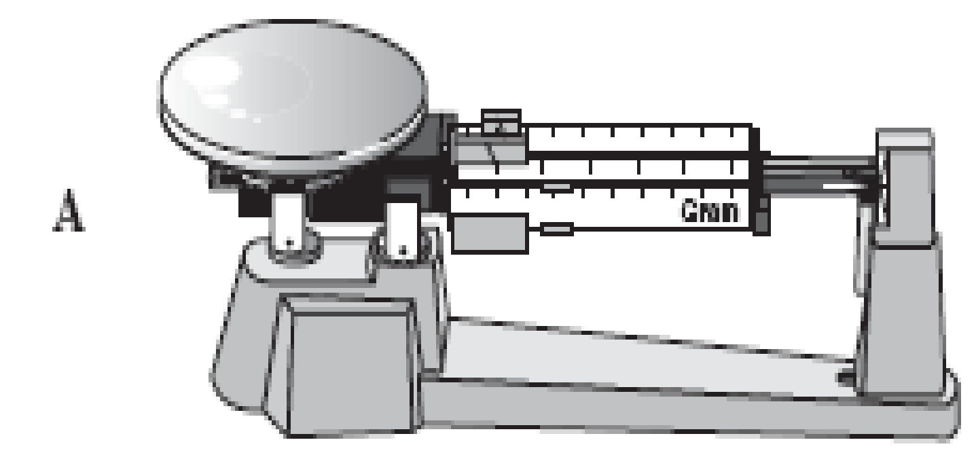
Balance
Mass, not Weight!
Function:
Measures the mass of an object
Measurements are in grams
NOT A SCALE

Slide 14
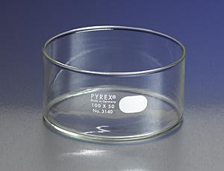
Culture Dish
Function:
A glass or plastic dish that biologists use to culture cells or hold specimens
Deeper than a petri but does not have a cover
Many sizes used

Slide 15
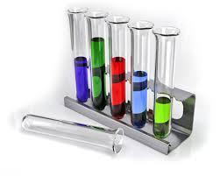
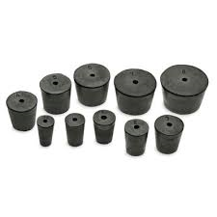
Test Tube & Rubber Stopper
Function:
Holds liquid chemicals
Glass or plastic tube with an open or stoppered end
Rubber stoppers can also be used on flasks

Slide 16
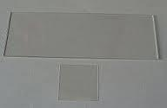

Microscope Slide, Cover Slip, and Depression Slide
Function:
A microscope slide is a long thin piece of glass that specimens are placed on for study under a microscope
A depression slide has a concavity in one surface over which a cover glass can be placed and that is used in biology for hanging-drop cultures
Cover slips are small squares of glass that cover the specimen placed on the microscope slide

Slide 17
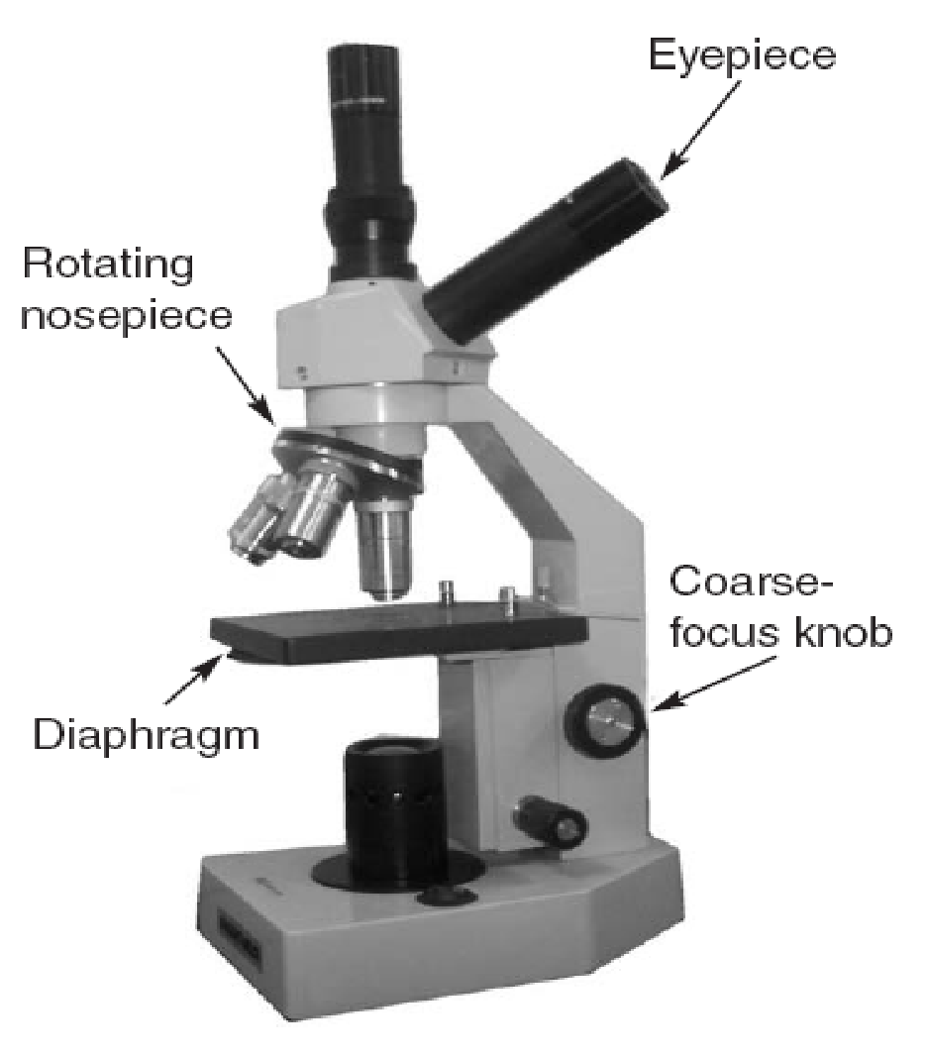
Microscope
Function:
Uses objective lenses to magnify small objects for observation
Magnifications can vary
Carry using TWO HANDS one on arm and other under base

Slide 18
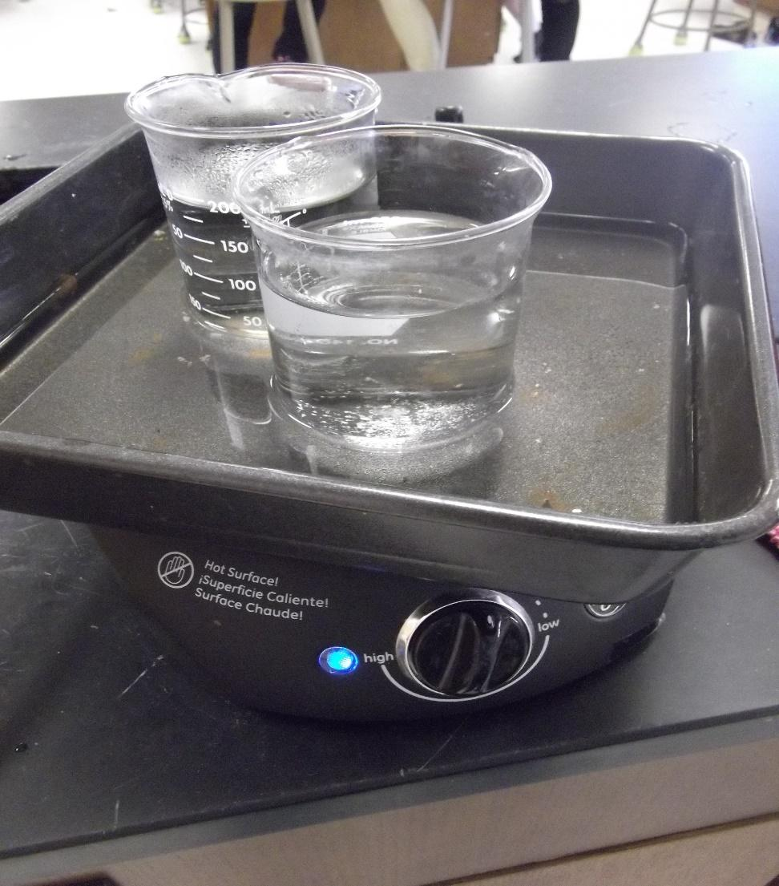
Hot Plate
Function:
Heats chemicals or other lab objects
Powered by electricity, not fire

Slide 19
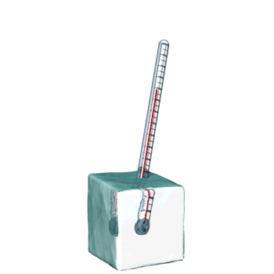
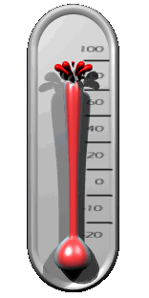
Thermometer
Hot or Cold
Function:
Measures temperature
Measurements reported in degrees Celsius

Slide 20
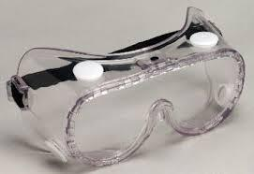
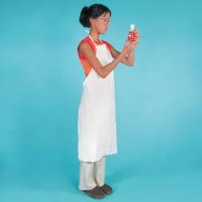
Goggles & Apron
SAFETY and PROTECTION!!!

Slide 21
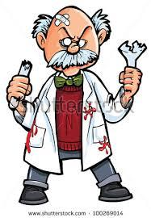
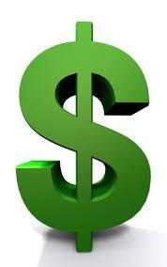
SAFETY for YOU and the Equipment!
Broken Equipment
Costs

